Slide 1

CAPSTONE PROJECT Amazon Bestselling Books Analysis with Python
Presented By
Student Name: RAvi ANjan KUmar
College Name: C.V.RAman Global university
Department: Computer Science Engineering
Email ID: ravianjank5@gmail.com
AICTE Internship Student ID : STU67f7539dac36f1744262045
Student ID : 2201020409

Slide 2
OUTLINE
Problem Statement
Proposed System/Solution
System Development Approach
Algorithm & Deployment
Result (Output Image)
Conclusion
Future Scope
References

Slide 3
Problem Statement
With millions of books sold annually on Amazon, understanding which books and authors consistently perform well is crucial for publishers, authors, and marketers. This project analyzes Amazon’s top 50 bestselling books from 2009 to 2019 to identify trends in genre popularity, author success, and book title features. By examining fiction and non-fiction sales over time, the analysis aims to provide insights into changing reader preferences and support better strategic decisions in the publishing industry.

Slide 4
Proposed Solution
The proposed system aims to address the challenge of analyzing trends and patterns in Amazon’s bestselling books from 2009 to 2019 to better understand genre popularity, author success, and book characteristics. This involves leveraging data analytics techniques to extract meaningful insights from historical sales and review data. The solution will consist of the following components:
Data Collection:
Gather historical data on bestselling books, including book titles, authors, genres, user ratings, reviews, and sales years.
Data Preprocessing:
Clean and preprocess the collected data to handle inconsistencies such as spelling variations and duplicate entries. Perform feature engineering to extract useful attributes like title length and punctuation percentage.
Data Analysis and Visualization:
Analyze the distribution of fiction vs. non-fiction genres across years. Identify top-selling authors in each category and visualize trends in their appearances and reviews.
Insight Generation:
Interpret the analyzed data to provide actionable insights on reader preferences, bestselling authors, and market trends over the decade.
Evaluation:
Assess the reliability of insights by validating data quality and consistency. Continuously refine analysis by incorporating new data or deeper feature extraction.
Result:
Enable publishers, authors, and marketers to make informed decisions regarding publishing strategies and marketing efforts based on data-driven trends and patterns.

Slide 5
System Approach
System Requirements
Software:
Python 3.x environment
Jupyter Notebook or any Python IDE for code development and execution
Libraries for data manipulation, analysis, and visualization
Data: Amazon bestselling books dataset (2009-2019) in CSV format, containing book titles, authors, genres, user ratings, reviews, and year of sale.
Libraries Required
Pandas: For data loading, cleaning, manipulation, and analysis.
NumPy: For numerical computations and array operations.
Matplotlib: For creating static, animated, and interactive visualizations.
Seaborn: For enhanced statistical data visualization built on top of Matplotlib.
String and Re: For text preprocessing, such as counting punctuations and handling string operations.
These libraries provide the foundation for loading, cleaning, exploring, and visualizing the data to extract meaningful insights about bestselling books and authors.

Slide 6
Algorithm & Deployment
Algorithm Selection:
For analyzing trends in Amazon bestselling books, exploratory data analysis and visualization techniques are used rather than a predictive machine learning model. However, if prediction is needed (e.g., forecasting book popularity), time-series models like ARIMA or deep learning models such as LSTM could be applied due to their strength in capturing temporal patterns.
Data Input:
The analysis uses features including book titles, authors, genres, user ratings, number of reviews, and year of publication. These features help identify patterns and trends over time.
Training Process:
While this project focuses on analysis, if predictive modeling were applied, the algorithm would be trained on historical data with cross-validation and hyperparameter tuning to optimize performance.
Prediction Process:
A trained model would use current and past data inputs to forecast future trends in book sales or popularity. Real-time factors such as emerging genres or seasonal reading trends could further enhance prediction accuracy.

Slide 7
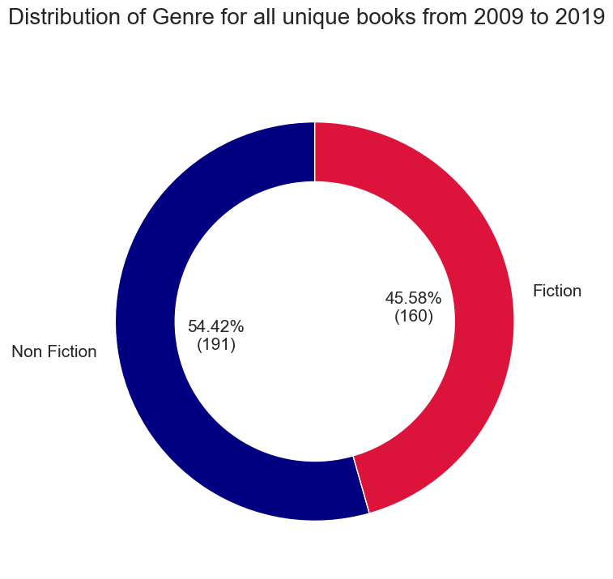
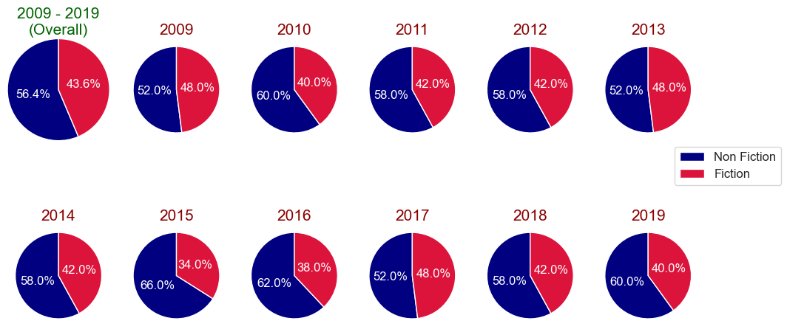
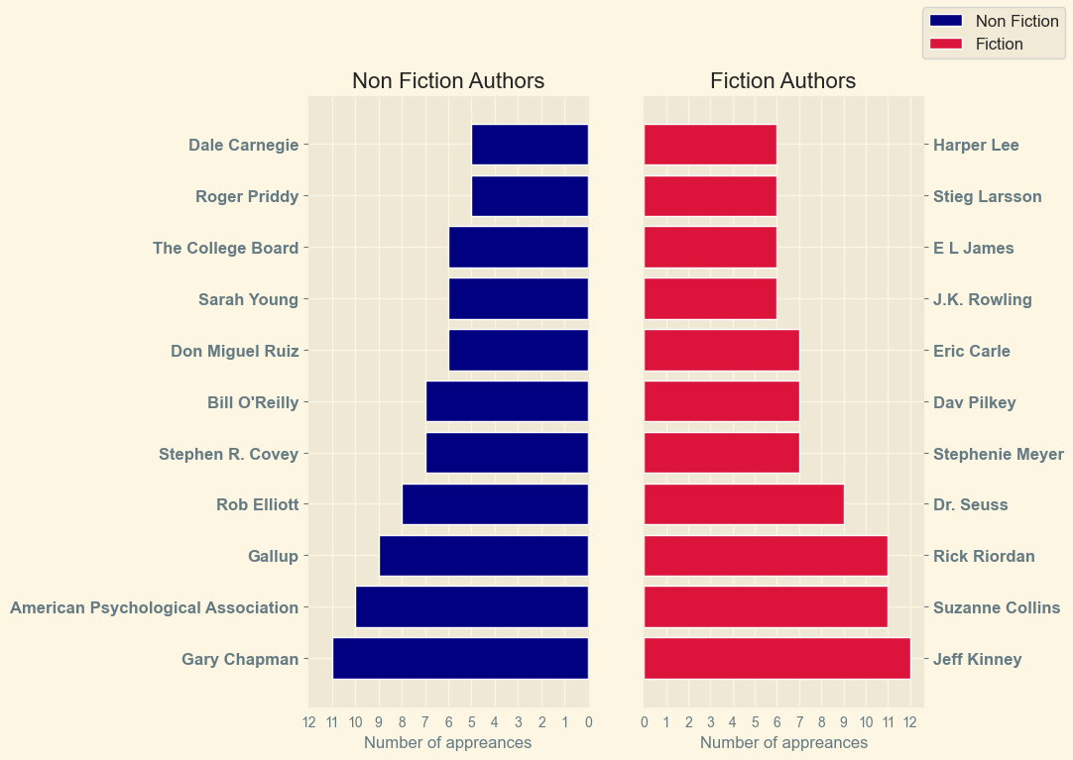
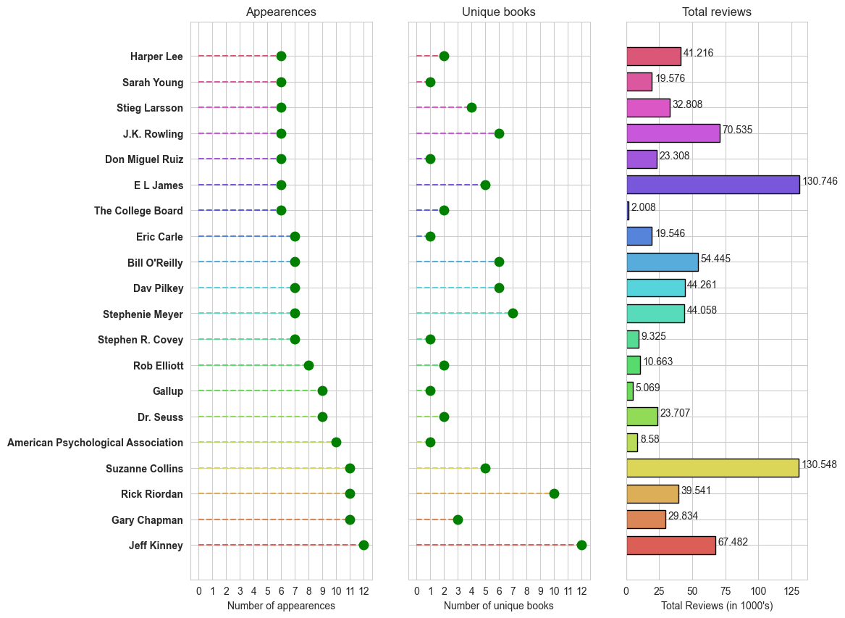
Result

Slide 8
Conclusion
This project provides valuable insights into the trends and patterns of Amazon’s bestselling books from 2009 to 2019. By analyzing data on genres, authors, and sales over time, we identified key factors influencing book popularity and market demand. The visualizations highlight shifts between fiction and non-fiction categories and reveal top-performing authors. This analysis can help publishers, authors, and marketers make informed decisions to better target readers and optimize book sales strategies.

Slide 9
Future scope
The project can be extended by applying machine learning models to predict future bestseller trends and sales patterns more accurately. Sentiment analysis of user reviews can provide deeper insights into reader preferences and influence on book popularity. Developing personalized recommendation systems can improve user experience by suggesting books tailored to individual tastes. Additionally, integrating real-time data such as social media trends, marketing campaigns, and author events could enhance the responsiveness and accuracy of analysis. Exploring more detailed genre classifications and combining data from multiple platforms would offer a more comprehensive understanding of the book market.

Slide 10
References
GitHub Link: https://github.com/ravianjankumar/Amazon-Bestselling-Books-Analysis-with-Python
Dataset Link: https://www.kaggle.com/datasets/sootersaalu/amazon-top-50-bestselling-books-2009-2019?resource=download

Slide 11
Thank you

